Slide 1
SAP BTP Architect Training
Day 3
Anubhav Oberoy
www.AnubhavTrainings.com
Follow excellence with sheer passion

Slide 2


DISCLAIMER
The training content and delivery of this presentation is confidential, and cannot be recorded, or copied and distributed to any third party, without the written consent of Anubhav Trainings

Slide 3
Agenda – Day 3
01
Understanding Aspects and associations
04
Generic Service handlers
02
05
Working with Service Layer
Introduction to Fiori Elements
04
06
Business Application Studio
Adding UI module

Slide 4
Reuse Types and aspects
When we design database artefacts, at times we have many similar objects and their data types. Instead of hardcoding the type as primitive type, it is recommended to create custom data types. Using custom data type increase reusability and reduce maintenance.
When we create a separate CDS file for reuse purpose and consume it. This file contain types, enumerators and aspects.
Every project would need some common aspects and types related to primary key generation, admin data (created by, created on, changed by, changed on) – temporal, Currency.
Aspect (structures in abap) is combination of many fields.

Slide 5

Hands on: Service creation
Solution
https://github.com/soyuztechnologies/BTP_Architect_Training/blob/master/Day%204/02srv.zip

Slide 6
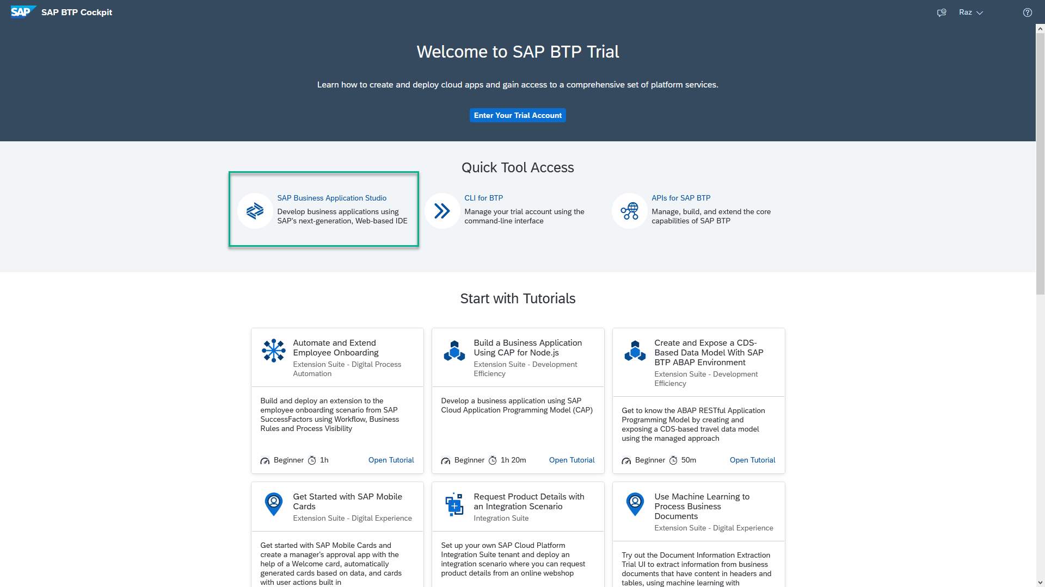
Business Application Studio
SAP Business Application Studio is a development environment available on SAP Business Technology Platform. Before you can start developing using SAP Business Application Studio, administrators must perform the required onboarding steps that are described in this tutorial.
In an Enterprise Account you can set up SAP Business Application Studio as a Free-Tier service by checking its free plan during its entitlement configuration.

Slide 7
Dev Space in BAS
VM
2GB
Dev Space
@cds/dk
VM
2GB
Business Application Studio
PaaS – BTP – Manager of this entire infrastructure
IaaS – AWS – Computer Running on internet
Bunch of servers with hardware – 1000 GB

Slide 8


Hands on: Move App to BAS

Slide 9
Generic Handlers in CAP
The CAPM framework generates most of the code to perform CURDQ operations on the entity. It does not know what validations to perform on our business data. As a developer, when we want to attach a pre-check (validations) / post-check (post processing code) on an entity operation, we can use generic handlers. All these operations are performed SYNCHRONOUSLY.
At times we want to
Take full control of our implementation
We want to add some validation before data is inserted or updated
We want to change data before insert/update
Read some extra information while GET calls
Fiori app
odata
cap
Generic handlers
database
before
on
after

Slide 10

Hands on: Generic Handlers

Slide 11
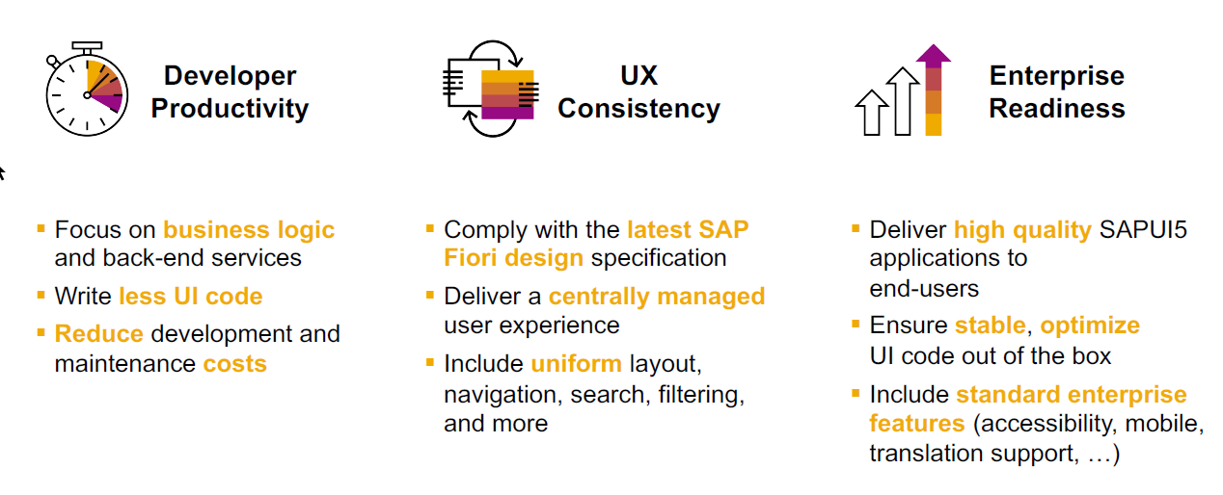
SAP Fiori elements boosts SAP Fiori development efficiency

Slide 12
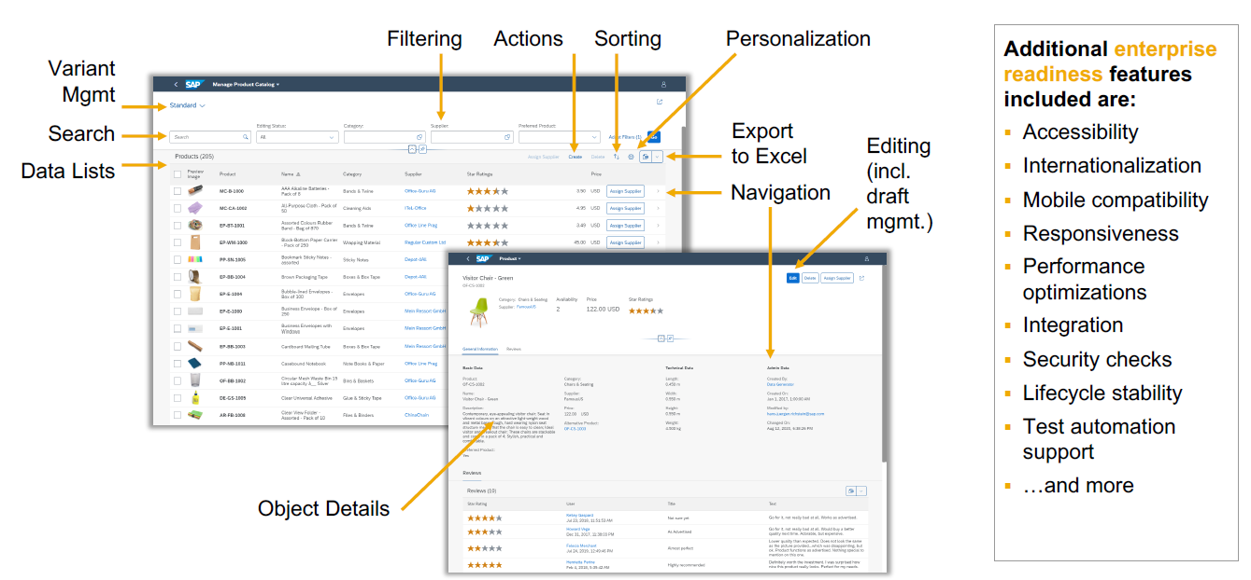
SAP Fiori elements provides enterprise-ready apps out of the box

Slide 13
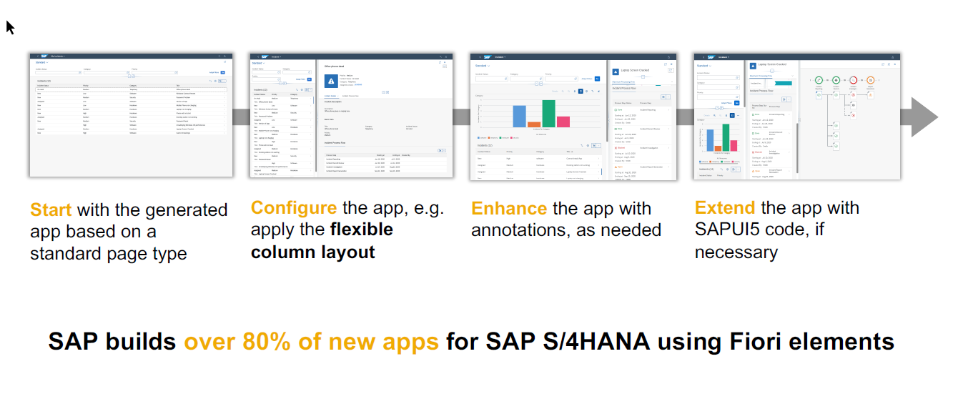
SAP Fiori elements application architecture provides flexibility

Slide 14
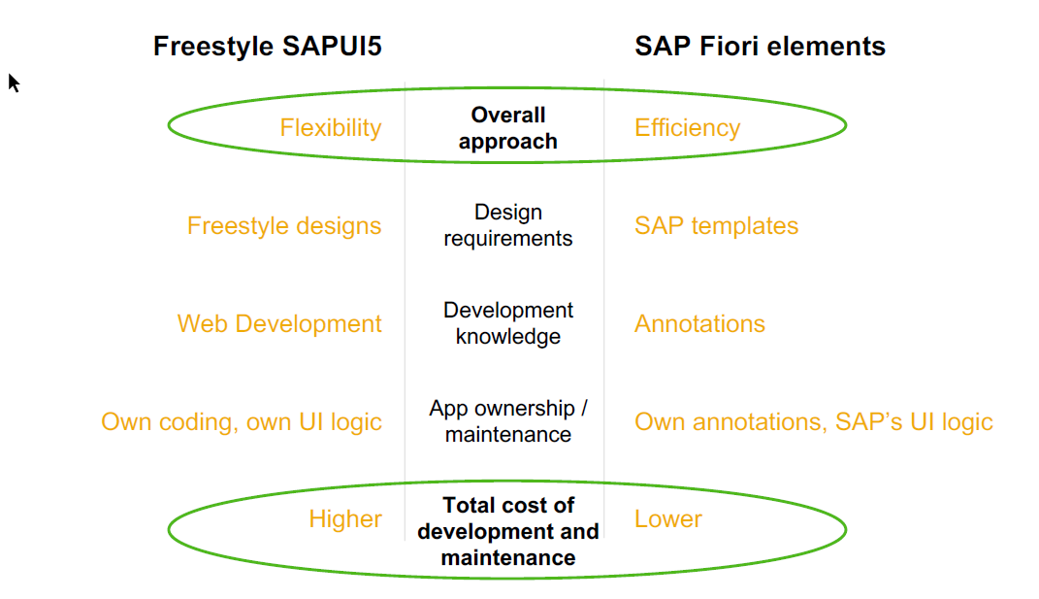
SAP Fiori elements prioritizes efficiency over flexibility

Slide 15

Hands on : Fiori App

Slide 16
Association v.s Composition
Association – a relationship between entities which is a lose coupling. Both objects should exist together. However, they can work independently. Airplane and passenger.
Composition – a relationship between entities which is a tight coupling. Both objects must exist together. They cannot function independently. Airplane and wings.
Purchase Order Header
composition
Purchase order Items

Slide 17

Hands on: Create Enablement for app
Solution
https://github.com/soyuztechnologies/BTP_Architect_Training/blob/master/Day%204/03application.zip

Slide 18

What We Did
Let’s Summarize

Slide 19

www.anubhavtrainings.com
Thank You
End of Day 3

Slide 20


We’re committed to empower you to be
#FutureReady
through powerful training solutions.
We build the workforce of the future.
250+
Corporate Clients
40,000+
Learners Trained
25000+
Learners Placed
FREE WEBINARS
Sign up for free webinars with industry experts every fortnight!
Enroll Now!
Contact us today!
https://anubhavtrainings.com

